Slide 1
IMAGE IDENTIFICATION AND RECOGNITION USING NOVEL HYBRID ARCHITECTURE DEVELOPMENT FOR SATELLITE IMAGES
GUIDE : Ms.V.Sathiya, Assistant Professor
BATCH – 16
Elamathy S - 211417104058
Ridu Varshini.N - 211417104225

Slide 2
ABSTRACT
The continuous innovation and development of satellite technology has brought the world closer together.
At present, there are thousands of artificial satellites in the world, and the number of spacecraft working in orbit is increasing. With the constant exploration of outer space, there is inevitably a large quantity of space debris, e.g., lacquer, satellite debris.
But, nowadays even with the advancement of technology there is still a lag in predicting the space crafts and the related targets in an accurate manner.
In this project we will be focusing on developing a novel architecture by effectively modifying squeezenet for determining the different types of satellite images and classifying between satellite and asteroids, where four different kind of pre-processing techniques as well as two different optimization techniques will be used to increase the accuracy of the proposed model.
By this project, we will be able to recognise any kind of satellite images given as an input to the generated model.
Thus, we propose a solution for the determination of spacecraft and asteroids with the most accurate prediction by developing a novel architecture.

Slide 3
LITERATURE SURVEY
Year of Publishing | Author Name | Title of the Paper | Merits | Demerits
2020 | Daqi Liu, Bo Chen, Tat-Jun Chin , and Mark G. Rutten | Topological Sweep for Multi-Target Detection of Geostationary Space Objects | The system provides a solution to detect the geostationary objects | The accuracy is very poor compared to other state of the art methods.
Link of the paper
https://ieeexplore.ieee.org/document/9185021

Slide 4
LITERATURE SURVEY
Year of Publishing | Author Name | Title of the Paper | Merits | Demerits
2019 | Joon-Ho Lee, Hyun-Jin Moon, and So-Hee Jeong | Numerically Efficient Determination of the Optimal Threshold in Natural Frequency-Based Radar Target Recognition | The scheme is validated by comparing the threshold obtained from the Newton iteration with that using the probability density function | The results are based out of potential assumptions alone making it un reliable.
https://ieeexplore.ieee.org/document/6891312
Link of the paper

Slide 5
LITERATURE SURVEY
Year of Publishing | Author Name | Title of the Paper | Merits | Demerits
2018 | Xueru Bai , Member, IEEE, Xuening Zhou, Feng Zhang, Li Wang, and Ruihang Xue . | Robust Pol-ISAR Target Recognition Based on ST-MC-DCNN | The system has shown robustness to image scaling, rotation, and combined deformation | The system cannot tackle the inherent unknown deformation
https://ieeexplore.ieee.org/document/8804365
Link of the paper

Slide 6
LITERATURE SURVEY
Year of Publishing | Author Name | Title of the Paper | Merits | Demerits
2017 | Jifang Pei, Student Member, IEEE. Yulin Huang, Member, IEEE. Weibo Huo,Yin Zhang, Member, IEEE. | SAR Automatic Target Recognition Based on Multiview Deep Learning Framework | The proposed framework is able to achieve a superior Recognition performance,and requires only a small number of raw SAR images for network training samples generation | However, it is too difficult to effectively trainthe deep neural networks with limited raw SAR images
https://ieeexplore.ieee.org/document/8207785
Link of the paper

Slide 7
LITERATURE SURVEY
Year of Publishing | Author Name | Title of the Paper | Merits | Demerits
2016 | Chunlei Huo, Member IEEE, Zhixin Zhou, Kun Ding, Chunhong Pan | Online Target Recognition for Time-sensitive Space Information Networks | The proposed approach is more promising for time-sensitive space information networks | The key difficulties of online target recognition task for space information networks lie in the contradiction between time sensitive response requirement and resource constraints
https://ieeexplore.ieee.org/document/7822901
Link of the paper

Slide 8
TECHNOLOGY STACK
Hardware Requirements (minimum):
RAM : 128 MB
Processor : Intel i3 or later
Hard disk : 100 MB
Software Requirements:
OS : Windows
Programming Language:
Python

Slide 9
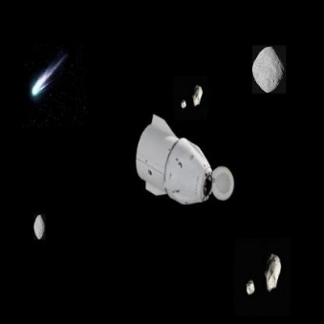
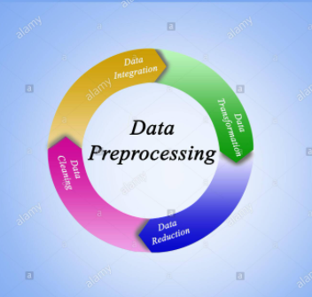
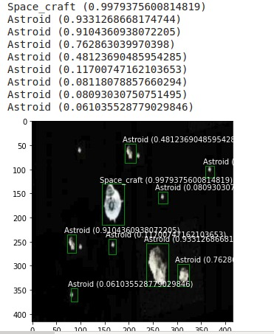
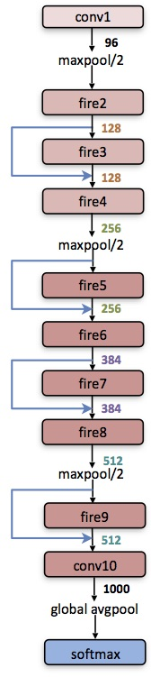
ARCHITECTURE DIAGRAM
.
Raw image
Pre processing
Output of space craft and asteroids with bounding box
Novel architecture (modified squeezenet algorithm)

Slide 10
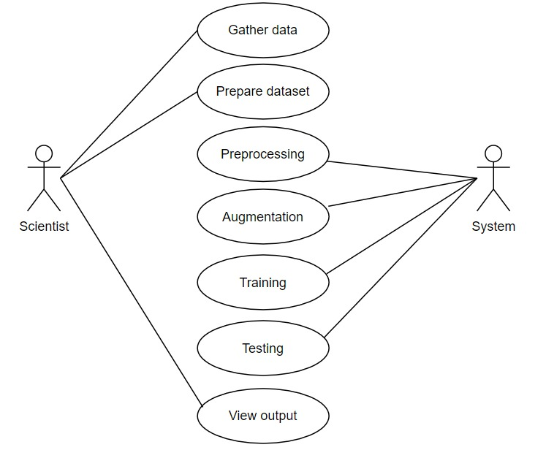
SYSTEM DESIGN – USE CASE DIAGRAM
.

Slide 11
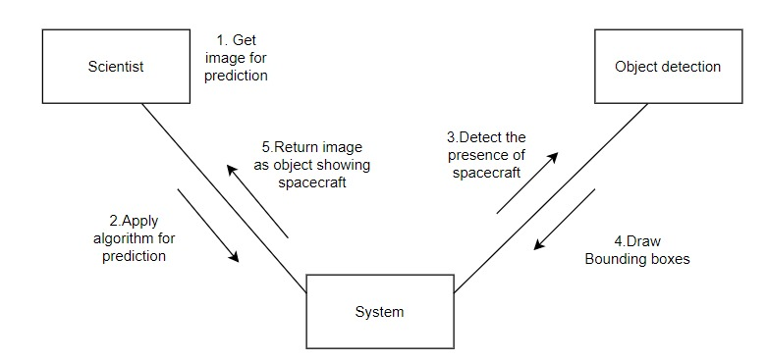
SYSTEM DESIGN – SEQUENCE DIAGRAM
.

Slide 12
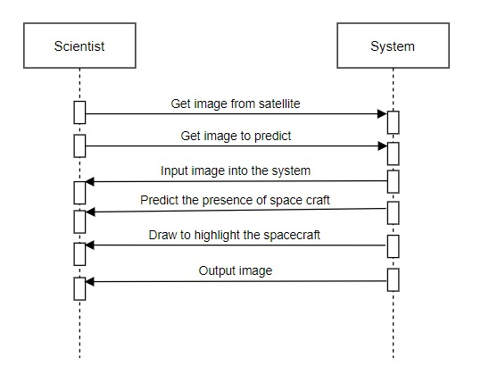
SYSTEM DESIGN – COLLABRATION DIAGRAM
.

Slide 13
MODULE DESCRIPTION
Dataset Collection Module
Preprocessing Data Module
Dataset Augmentation
Training with novel architecture
Object detection

Slide 14
DATASET COLLECTION MODULE
Dataset collection module is the process of collecting data that will be processed by the system for performing deep learning process.
There are three steps of collecting data,
Manually finding and downloading images takes a long time simply due to the amount of human work involved.
Since data has become such a valuable commodity in the deep learning era, much of the data can be found from third party resources.
Starting with a network pre-trained on a large dataset, and then fine tune on our own.

Slide 15
PREPROCESSING DATA MODULE
In this project the preprocessing data module is used to resize the images.
In deep Learning module the quality of the training data determines the quality of your model.
The data you will encounter in practice will be not clean in most cases. It means the data will contain non-uniform data formats, missing values, outliers, and features with very different ranges.
The data would not be ready to be used as training data for your model.
For those reason, the data must be preprocessed in various ways.

Slide 16
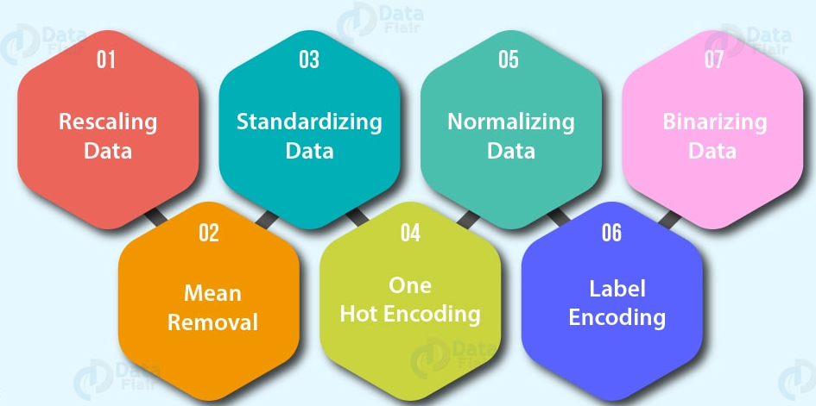

Slide 17
DATA AUGMENTATION MODULE
The performance of deep learning neural networks often improves with the amount of data available.
Data augmentation is a technique to artificially create new training data from existing training data. This is done by applying domain-specific techniques for example, from the training data we create new and different training data.
Image data augmentation is perhaps the most well-known type of data augmentation and involves creating transformed versions of images in the training dataset that belong to the same class as the original image.

Slide 18
DATA AUGMENTATION PROCESS DIAGRAM
LOAD THE COLLECTED IMAGE DATASET
ROTATION
WIDTH SHIFT
LOAD THE IMAGE
AUGMENTATION PROCESS
HEIGHT SHIFT
ZOOM MODE

Slide 19
TRAINING WITH NOVEL ARCHITECTURE
In this project, we make use of a effective novel architecture for training the dataset by modifying the squeezenet algorithm.
In designing the architecture the goal was to create a smaller neural network with fewer parameters that can more easily fit into computer memory and can more easily be transmitted over a computer network.
The novel architecture achieves an accuracy but with fifty times fewer parameters and a model size much smaller than 50 MB.

Slide 20
TRAINING

Slide 21
OBJECT DETECTION MODULE
Object detection is a process of finding all the possible instances of real-world objects, such as human faces, flowers, cars, etc. in images or videos, in real-time with utmost accuracy.
The object detection technique uses derived features and learning algorithms to recognize all the occurrences of an object category.
Object detection technique helps in the recognition, detection, and localization of multiple visual instances of objects in an image or a video.
It provides a much better understanding of the object as a whole, rather than just basic object classification.
This method can be used to count the number of instances of unique objects and mark their precise locations, along with labeling. With time, the performance of this process has also improved

Slide 22
OBJECT DETECTION DIAGRAM
INPUT IMAGE
START PROCESS
DETECT OBJECTS
DRAW BOUNDING BOXES

Slide 23
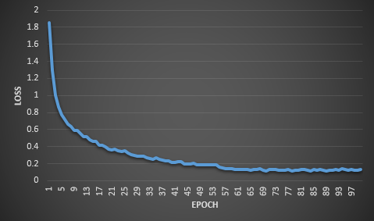
PERFORMANCE EVALUATION
The error for the current state of the model must be estimated repeatedly. This requires the choice of an error function, conventionally called a loss function. In our project the loss is reduced in each epoch during the training. The following graph depicts the loss during the training.
Loss graph

Slide 24
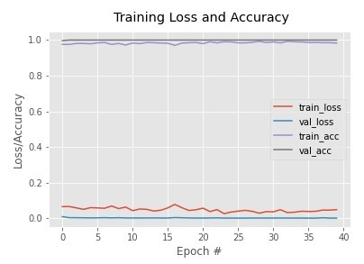
PERFORMANCE EVALUATION
The loss graph shows the training accuracy and training loss of our project during each epoch.
From the loss graph it is observed that the accuracy comes to stable after first few epoch.
An epoch is a term used in machine learning and indicates the number of passes of the entire training dataset the machine learning algorithm has completed.

Slide 25
COMPARISON WITH OTHER ARCHITECTURES
The following table has the comparison of our architecture with other architectures
Architecture | Mean Average Precision
Mobilenet SSD | 76.9% mAP
Faster RCNN | 73.2% mAP
Novel Hybrid | 81%mAP

Slide 26
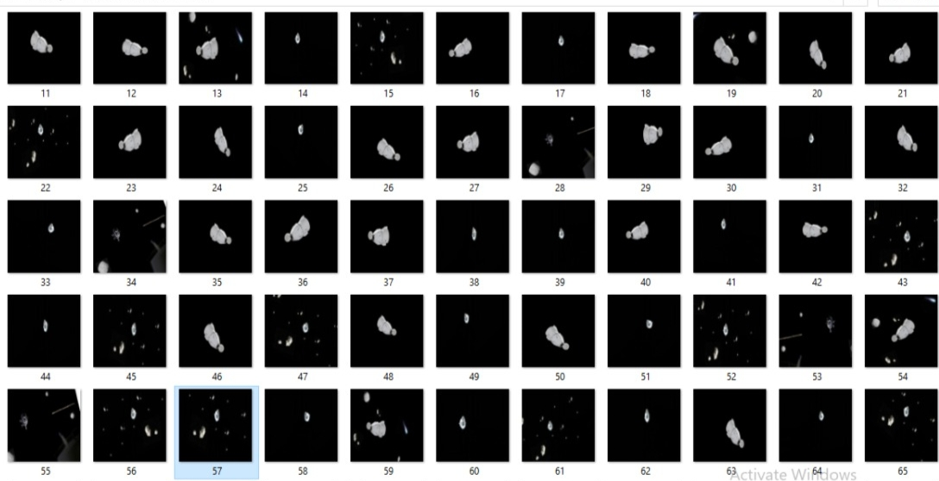
SCREENSHOTS
Dataset Collection

Slide 27
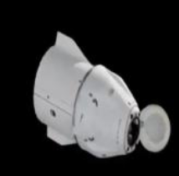
Image after preprocessing

Slide 28
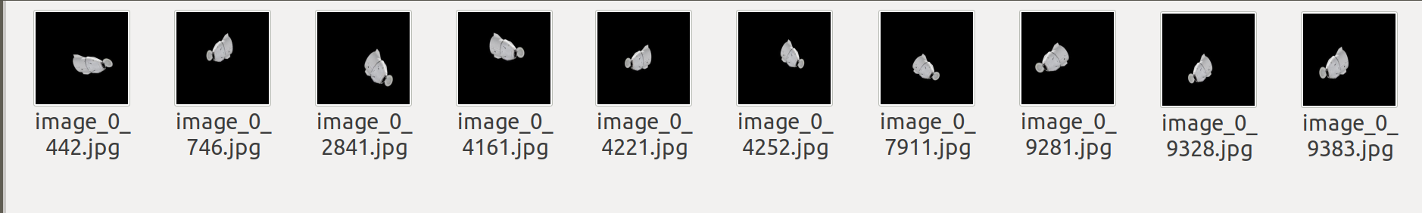
Image after augmentation

Slide 29
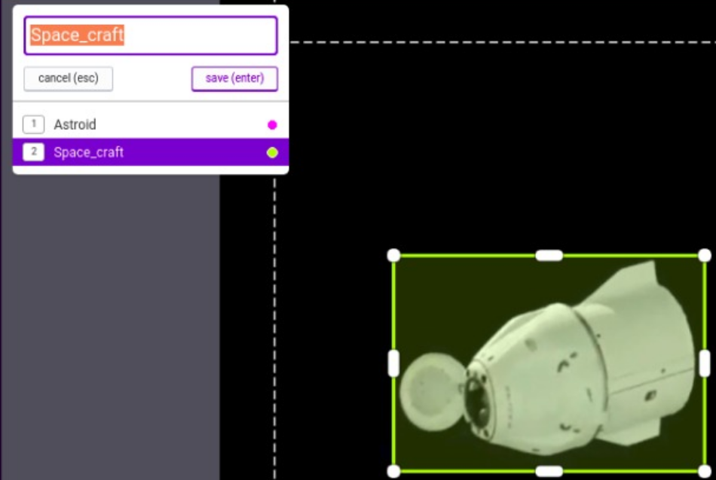
Labelling of dataset

Slide 30
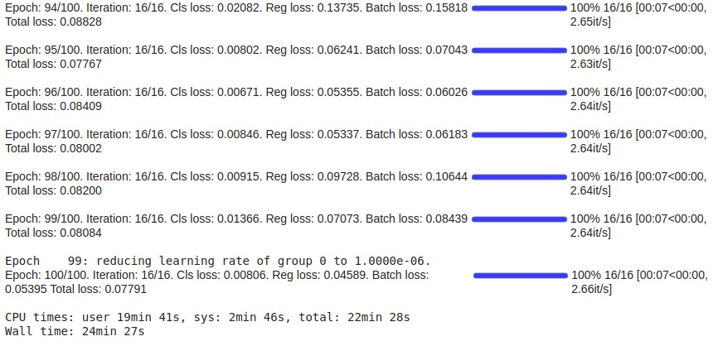
Training Process

Slide 31
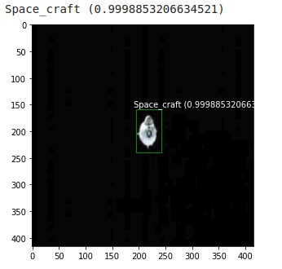
Spacecraft Detection

Slide 32
Multiply space object detection

Slide 33
Conclusion and future enhancements
Conclusion:
This project is successfully implemented for effectively identifying the spacecrafts using the available the deep learning approach.
This project is very helpful in providing a cheap yet effective solution to detecting spacecraft and space objects.
Future Enhancements:
In the coming future, we review the application of the space detection technology in the space exploration ﬁeld and it can promote for effective advancing the present technological methods.
In this field, there are more chance to develop or convert this project in many ways.
Thus, this project has an efficient scope in coming future where this idea can be converted to computerized space detection in a cheap way.

Slide 34
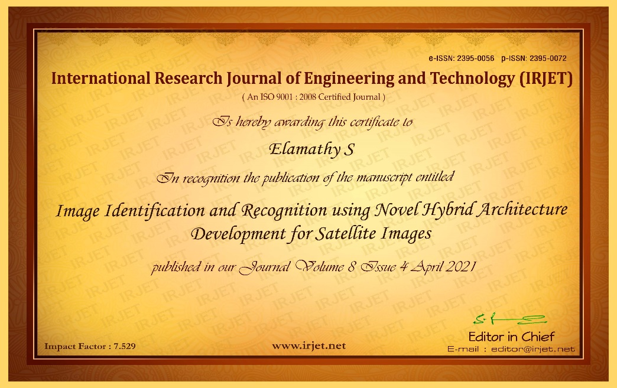
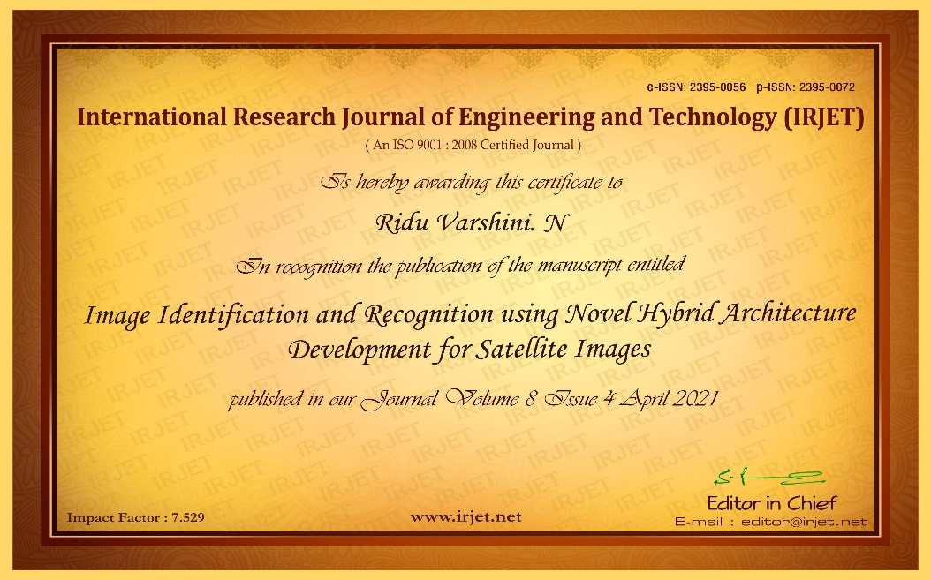
PUBLICATIONS
Journal name - International Research Journal of Engineering and Technology (IRJET)
Publication issue - Volume 8, Issue 4, April 2021
Link - https://www.irjet.net/archives/V8/i4/IRJET-V8I4114.pdf

Slide 35
REFERENCE
[1] Daqi Liu, Bo Chen , Tat-Jun Chin , and Mark G. Rutten,” Topological Sweep for Multi-Target Detection of Geostationary Space Objects”
[2] Joon-Ho Lee, Hyun-Jin Moon, and So-Hee Jeong,”Numerically Efficient Determination of the Optimal Threshold in Natural Frequency-Based Radar Target Recognition”
[3]Jifang Pei , Student Member, IEEE, Yulin Huang, Member, IEEE, Weibo Huo, Yin Zhang , Member, IEEE,”SAR Automatic Target Recognition Based on
Multiview Deep Learning Framework”
[4]Chunlei Huo, Member IEEE, Zhixin Zhou, Kun Ding, Chunhong Pan,”Online Target Recognition for Time-sensitive Space Information Networks ”
[5] Xueru Bai , Member, IEEE, Xuening Zhou, Feng Zhang, Li Wang,Ruihang Xue , and Feng Zhou , Member, IEEE,”Robust Pol-ISAR Target Recognition Based on ST-MC-DCNN”
[6] Tan Wu (a) , Xi Yang (a)* , Bin Song (a) , Nannan Wang (a) , Xinbo Gao (b) , Liyang Kuang (a) , Xiaoting Nan (a) , Yuwen Chen (a) , Dong Yang (c),”T-SCNN: A Two-Stage Convolutional NeuralNetwork for Space Target Recognition”

Slide 36


